Slide 1
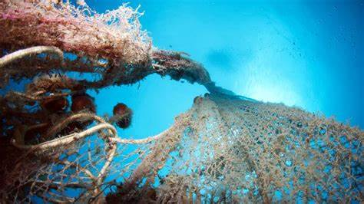
  Sustainability and Environment
Gianfederico Guastalla

Slide 2
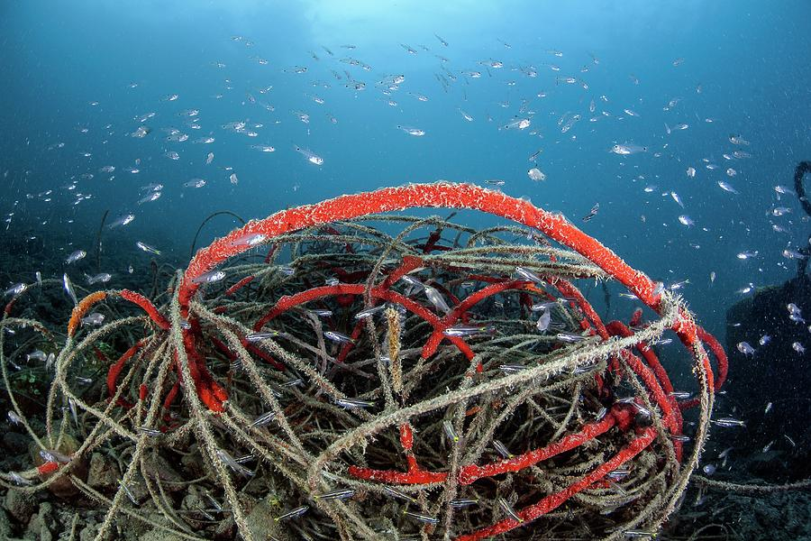
  About
  Sponsorship
  Ghost Nets
  How the project was born
  Hands-on
  Conclusion
Contents

Slide 3
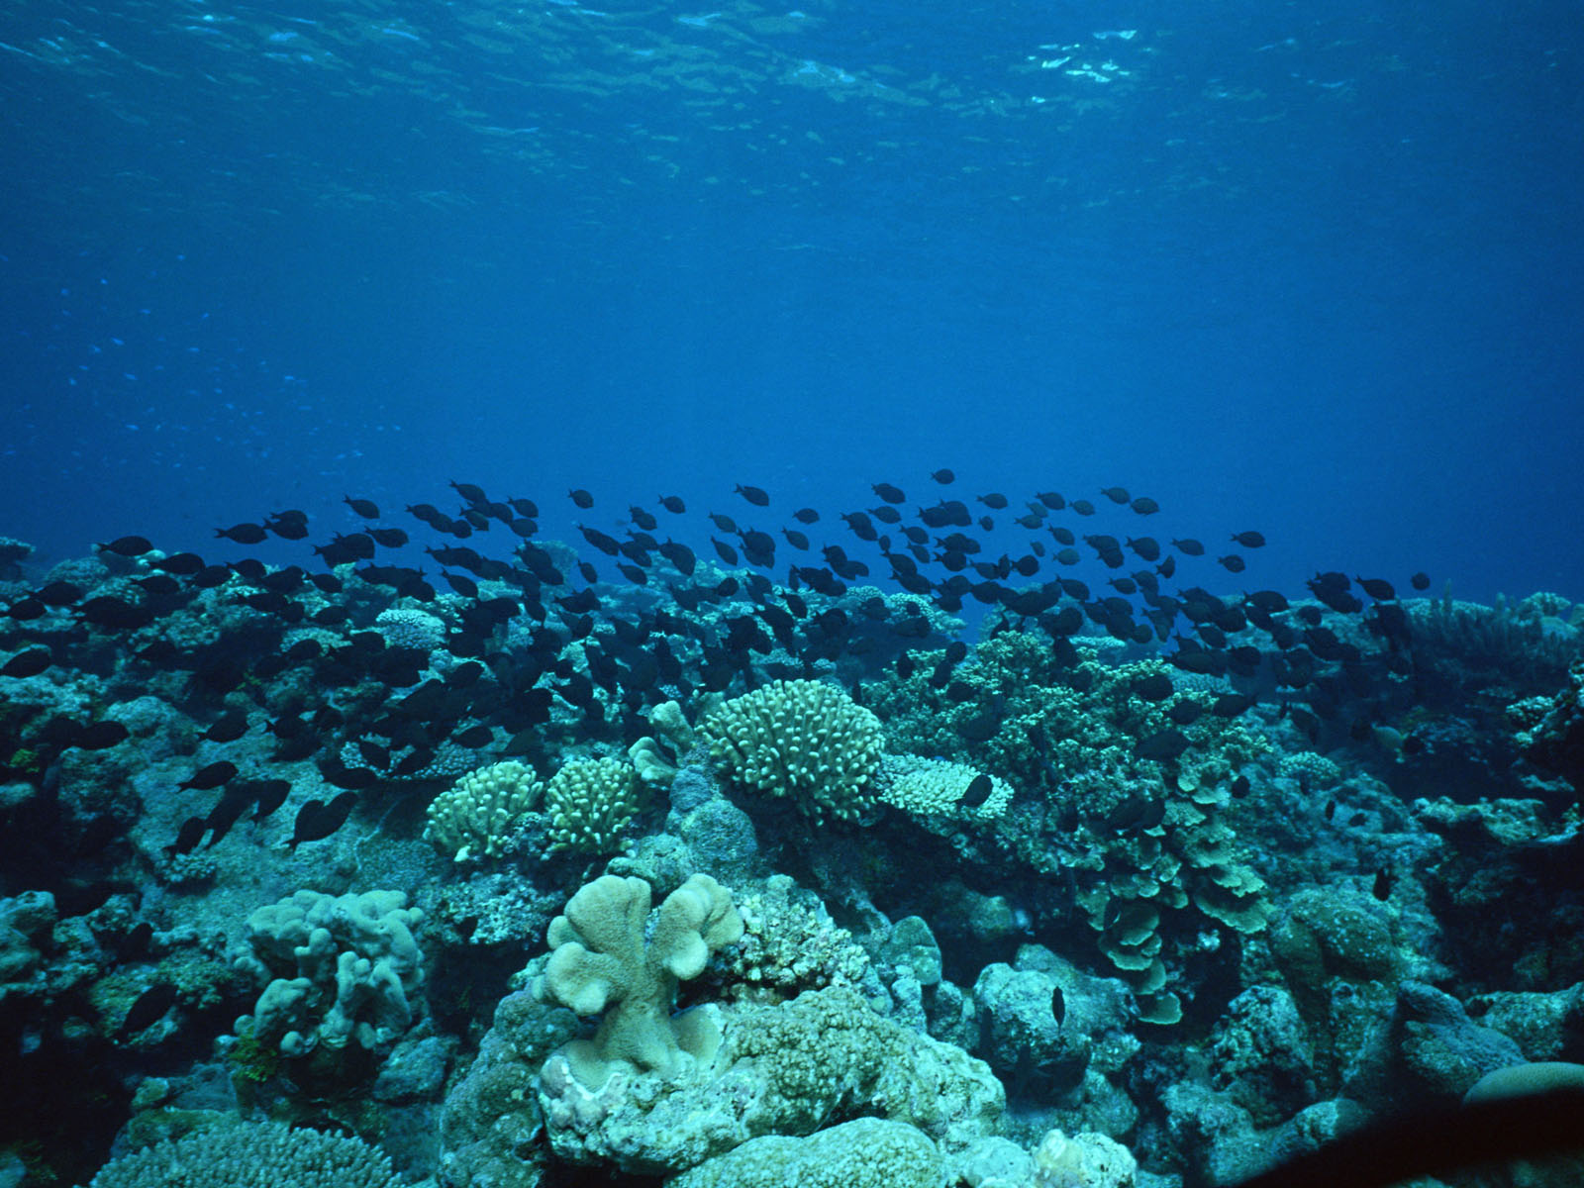
The MarineSeafloorConservation is a newly established organization that aims to remove polluting materials from the Mediterranean seabed. The organization is mainly focused on the removal of fishing gears, nets and lines accidentally or intentionally abandoned on the seabed.
About
To achieve our goal, we are planning for the acquisition of a vessel equipped with specific equipment, in addition a ROV (Remotely Operated Vehicle) acquisition is planned for the identification of polluted spots and for video assistance during recovery. We expect to acquire a vessel of around 25 meters in length, while for the ROV we are moving towards a type that can reach depths of around 500 meters. In addition, the vessel will be equipped with a multi-beam sonar for mapping areas identified as potentially polluted and acquiring 3D information on abandoned materials that could be a threat to the marine environment.

Slide 4
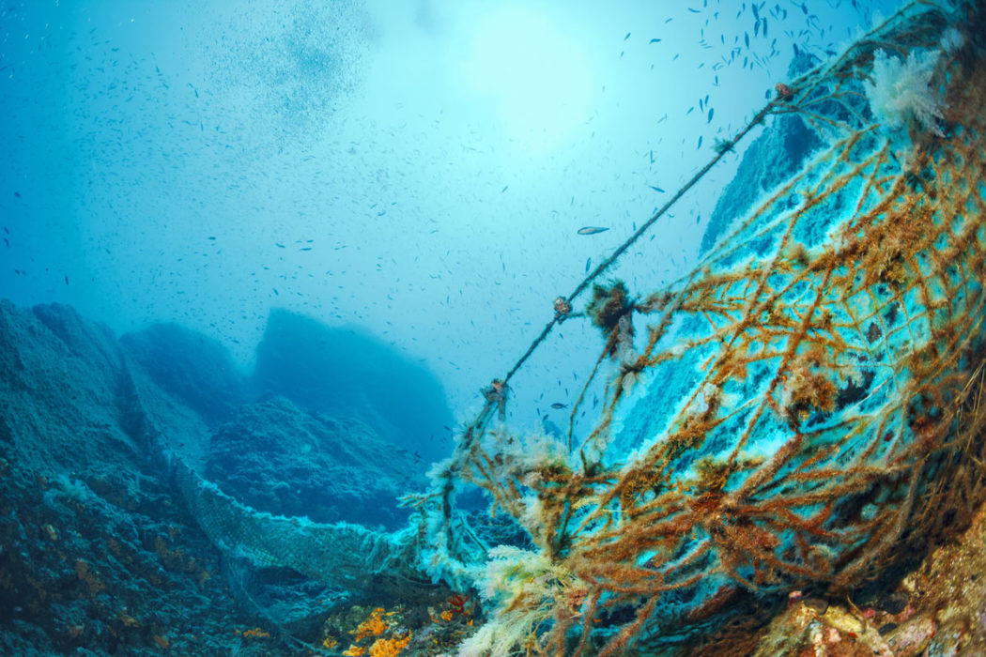
As far as the financial part is concerned MarineSeafloorConservation is looking for a company willing to sponsor this important project which is unique globally.
The exclusivity and current relevance of the project worldwide will bring significant positive effects in terms of advertising, furthermore the transformation of the recovered material into new products will be a further source of income. in addition to the revenue above, our strategy is to acquire funds from both memberships, donations, EU Funding Programmes.
Sponsorship

Slide 5
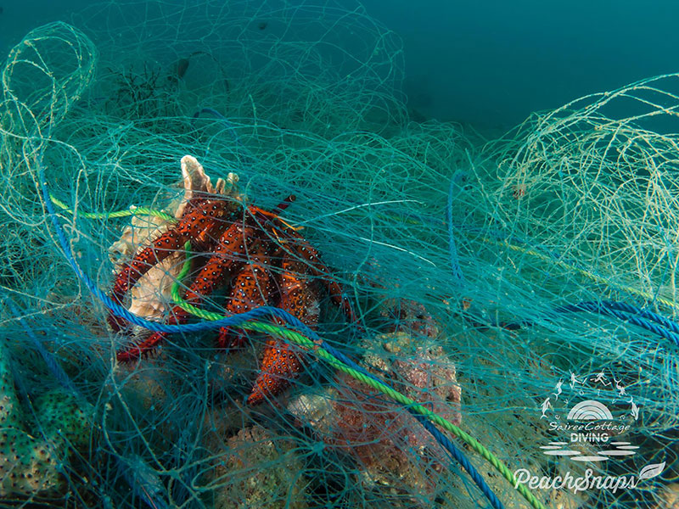
Ghost Nets
There are many organizations involved in the recovery of plastic material from the surfaces of the seas and from the beaches we would like to recover starting from the seafloor. Although the abandoned fishing gears are not visible, are still pose a threat to marine life, which becomes trapped in it. In addition, the microplastics produced by the degeneration of plastic materials, enter and are transferred within the food chain, therefore not being an inert material, the release into the environment of these microscopic particles deriving from human activities, also has direct effects on the integrity of the genetic heritage with long-term consequences on populations, communities and entire ecosystems;

Slide 6
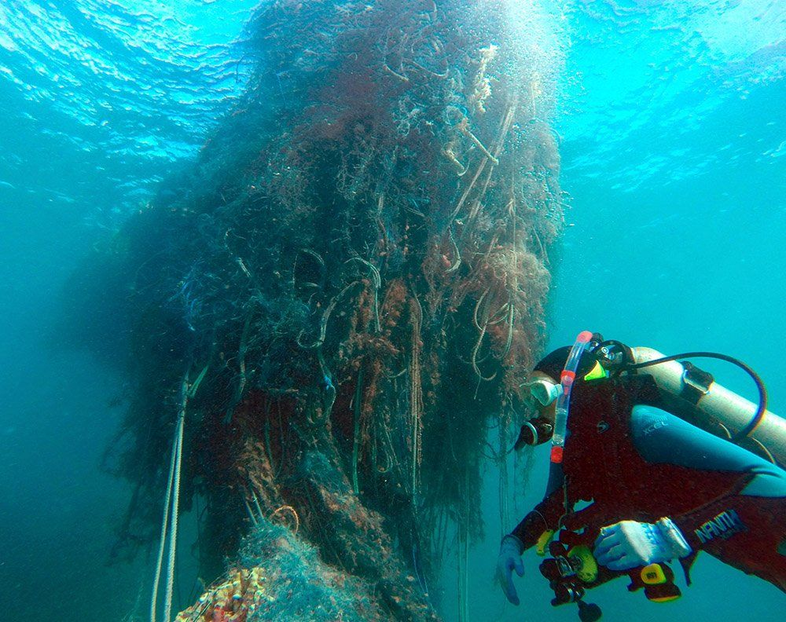
How the project was born
The project has developed following
few episodes that occurred during my career on board cruise ships. Leaving from the anchorages it happened to recover huge skeins of cables and fishing nets stuck in the anchor.
I began to take an interest in marine pollution issues, during my nautical studies and during my career on board, however, noticing that all the interest in marine pollution issues was mainly focused on the pollution of sea surfaces, while the interest on the conditions of the seabed, perhaps because they were not visible, were rather scarce.

Slide 7
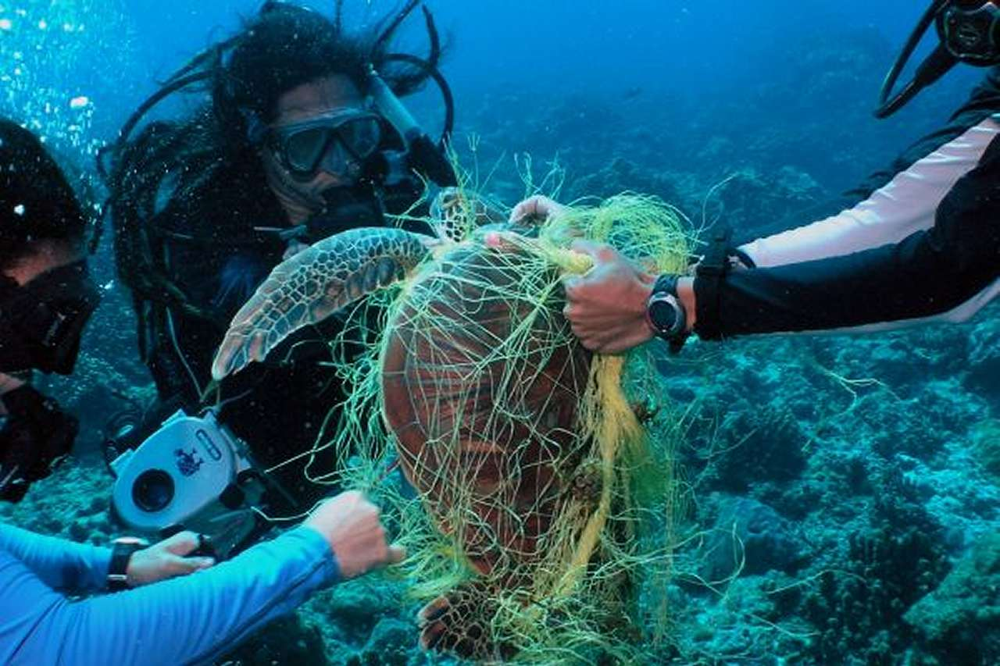
There are many studies and mappings carried out mainly by universities or oceanographic institutes in order to raise awareness and inform the various government institutions. In my opinion, in order to follow up concretely the studies and mapping of the most polluted sites, it is necessary to take concrete action to identify and remove the greatest possible amount of fishing gears and lines deposited on the seabed. The areas on which I plan to intervene initially, concern the seabed in the coastal areas of north-westerly of Mediterranean sea, such as Italian and France coast, up to north-eastern coast of Spain.
Hands-on

Slide 8
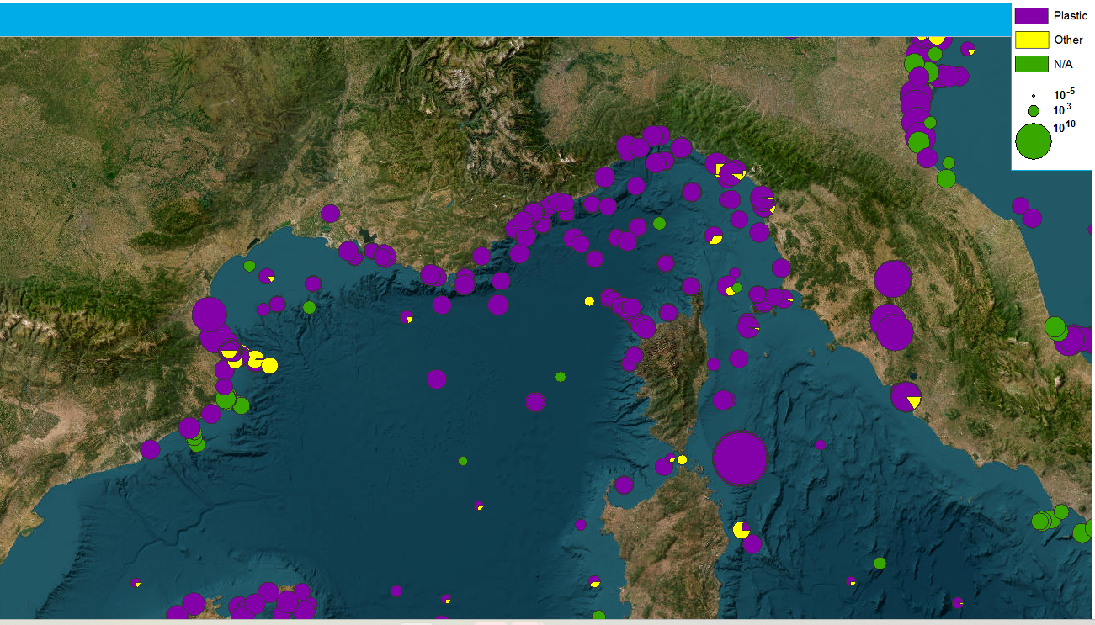
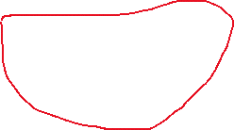
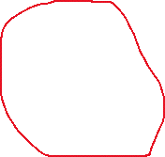
MAP OF POLLUTED SITES (North-West Mediterranean)
Alfred Wegener Institut-AWI Litterbase

Slide 9
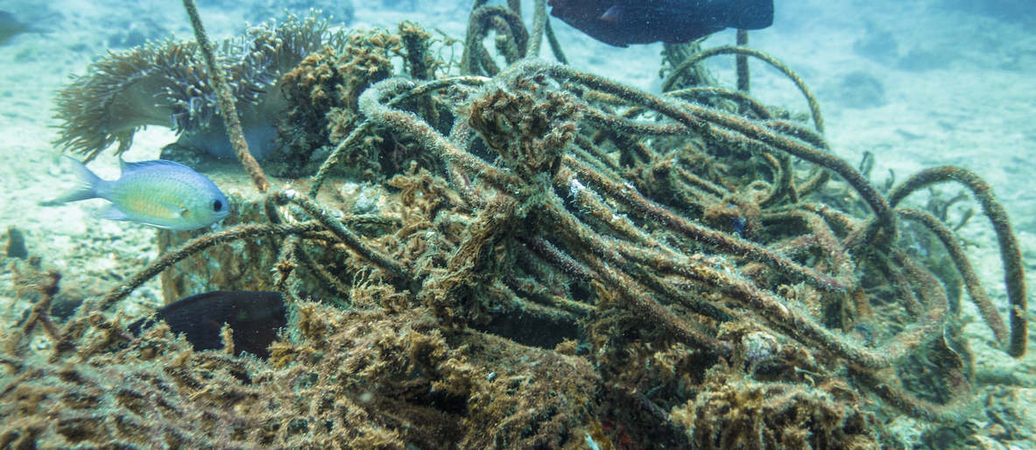
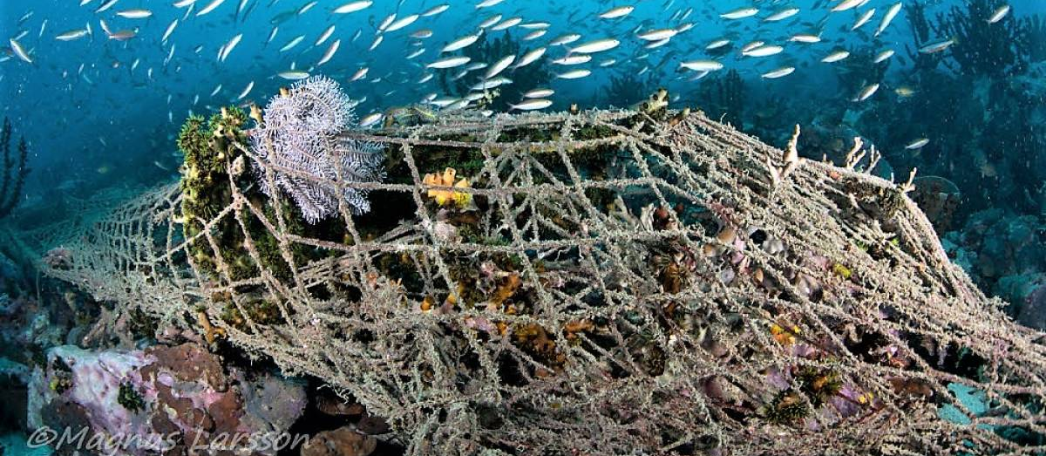
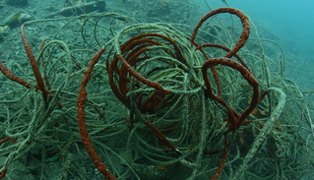

Slide 10
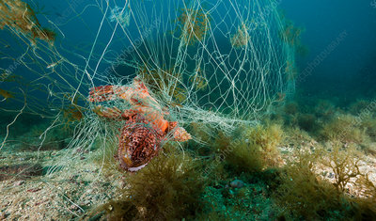
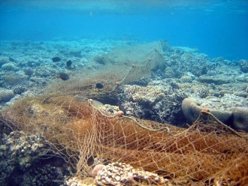

Slide 11
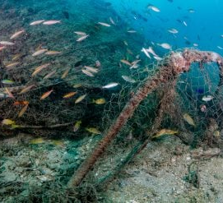
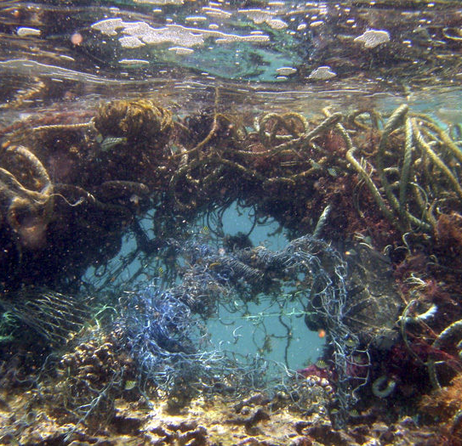
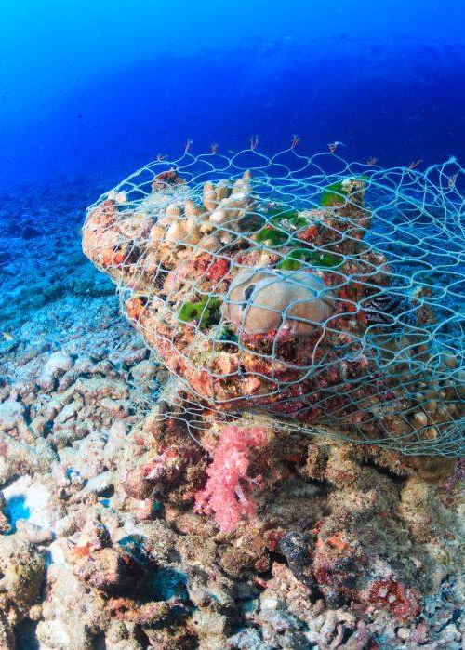

Slide 12
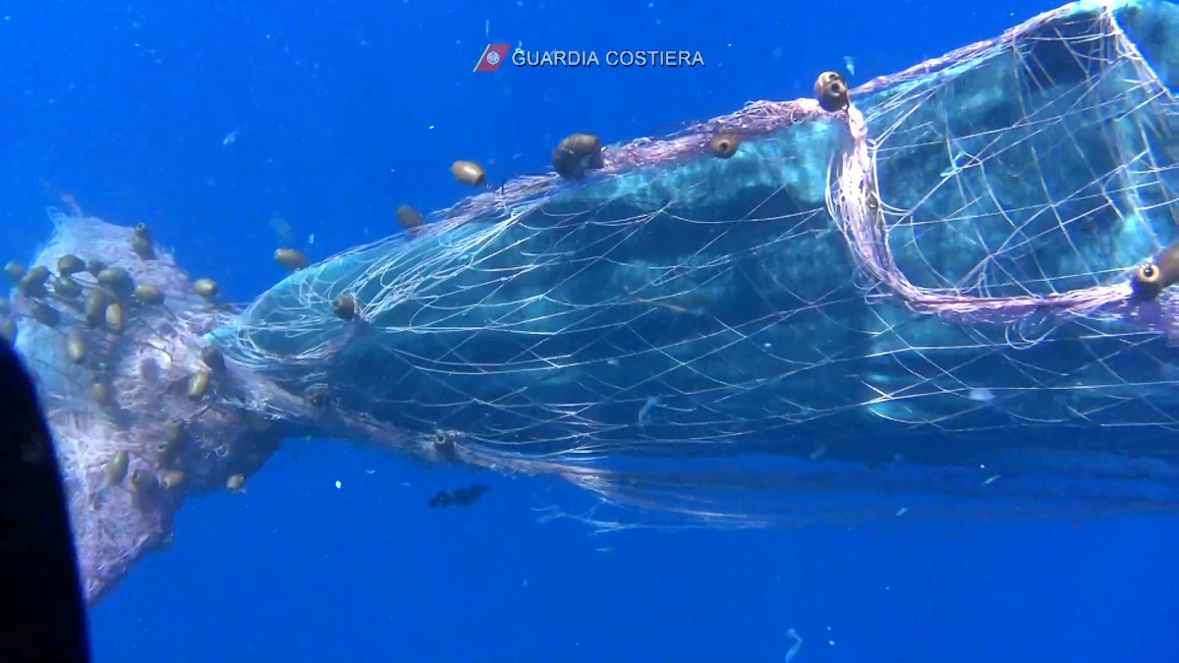
Conclusion
Fishing nets, cables, lines, which are made of plastic material, are the main target of our removal and disposal. Together with our partners we could give a real contribution to reducing plastic in the seas.

Slide 13
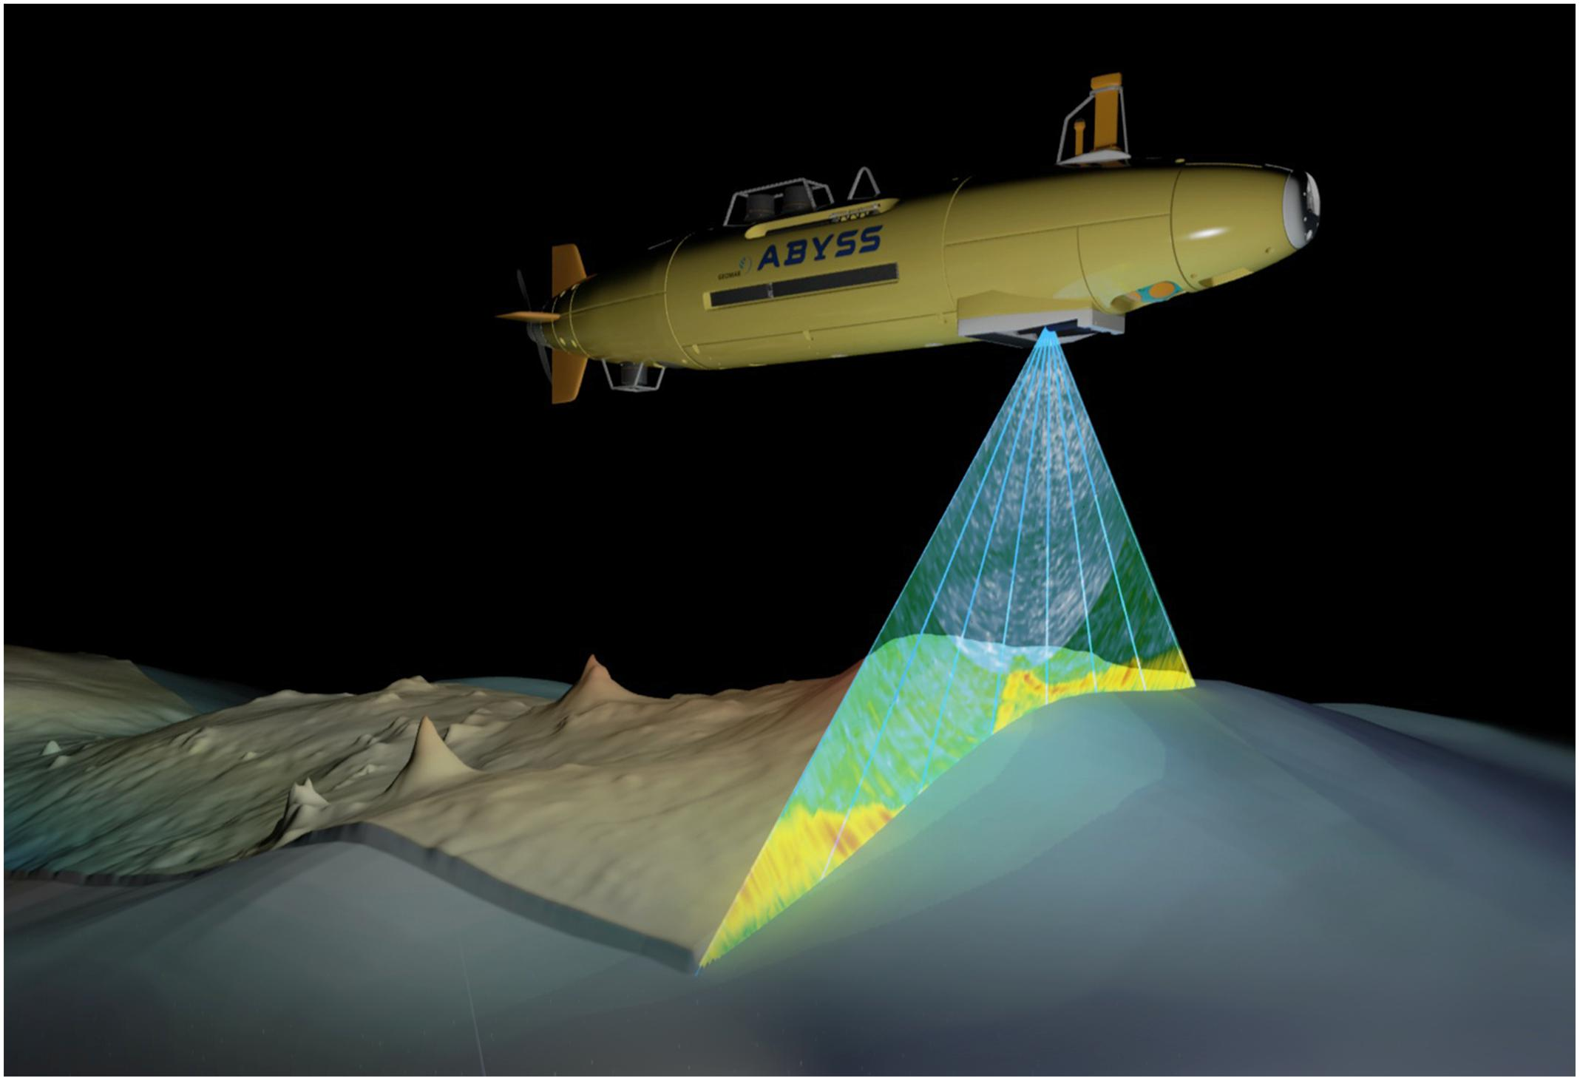
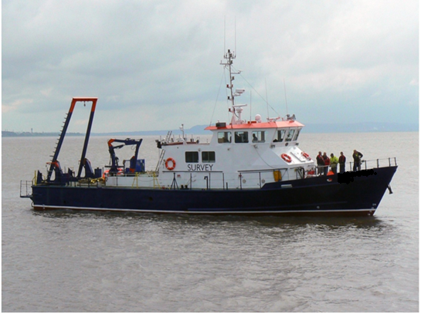
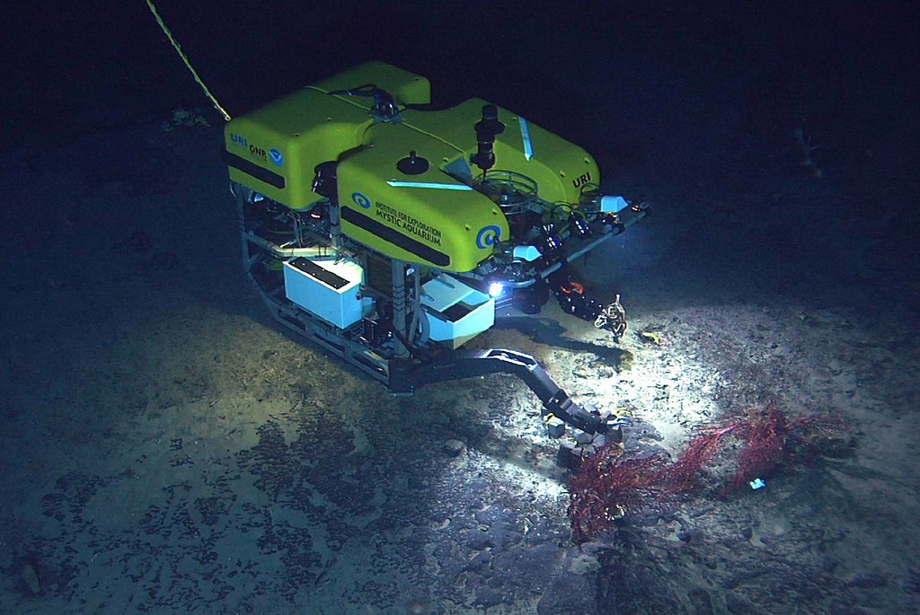
TYPE OF VESSEL & ROV PLANNED TO ACQUIRE

Slide 14
Conservative BUDGET

Slide 15
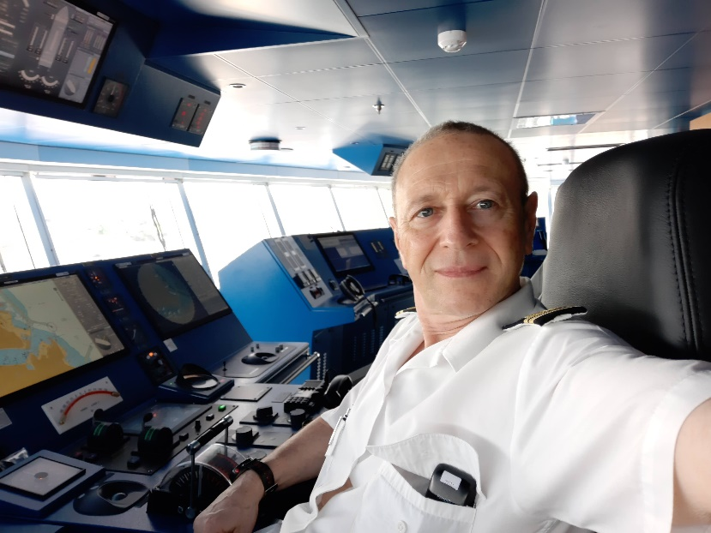
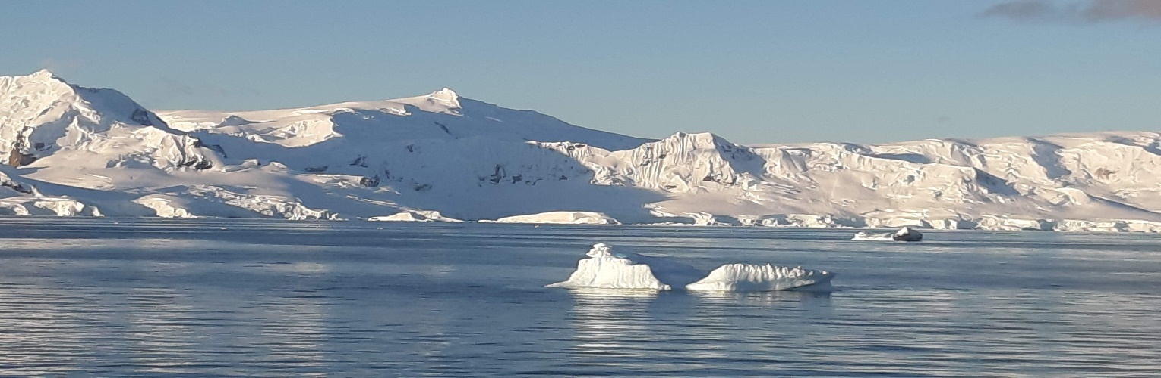
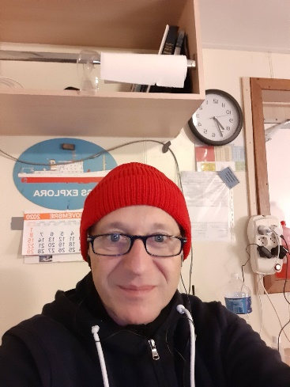
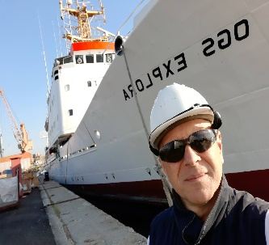
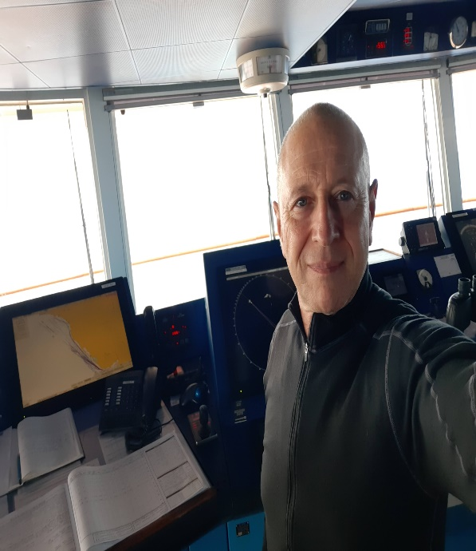
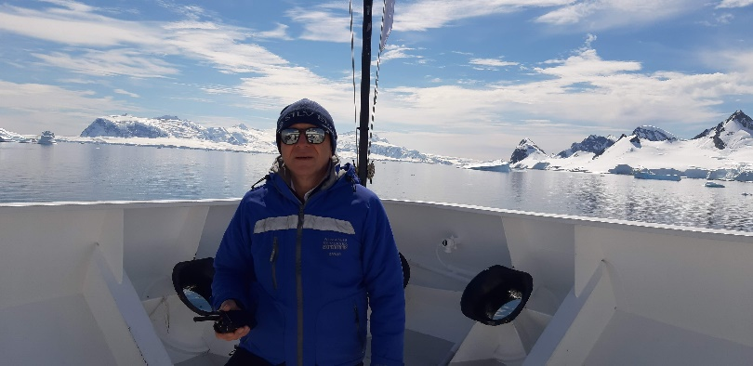
I was born in Genoa, Italy in 1963. I graduated as a Master Mariner at the State Maritime Institute of Genoa. I started sailing as Deckboy up to Captain position. I spent more then 20 years on board various types of ships including an Oceanographic Research Vessel and two Expedition Ships. I also worked as a Ship Manager at some ship management companies in Switzerland. I am certified as Master of ships over 3000 GT. After years spent sailing on the sea surface, I would like to take care of the Mediterranean Marine seafloor giving my contribution to reducing plastics from the seas.
About me

Slide 16
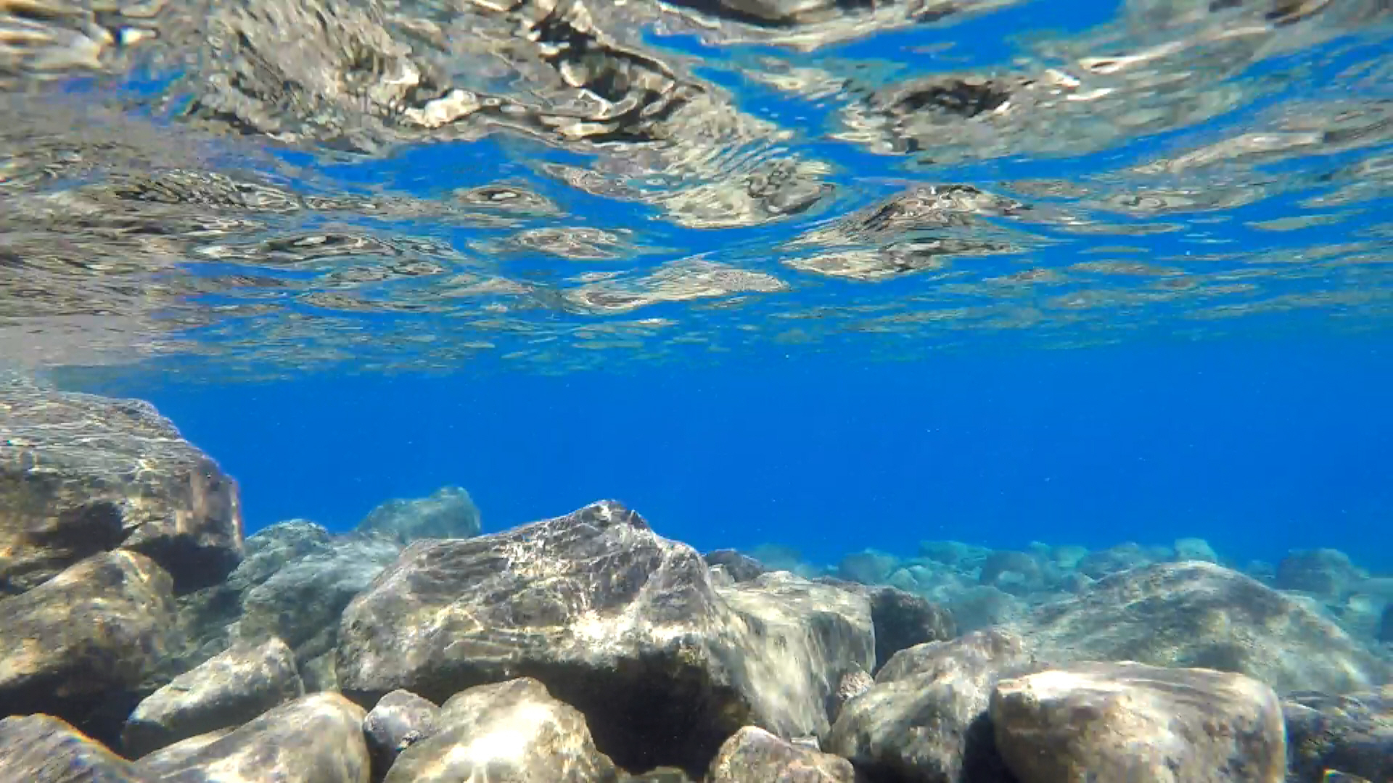
Thanks
Capt. Gianfederico Guastalla

